Slide 1


Kitchen Around You
The world’s kitchen’s at your fingertips

Slide 2
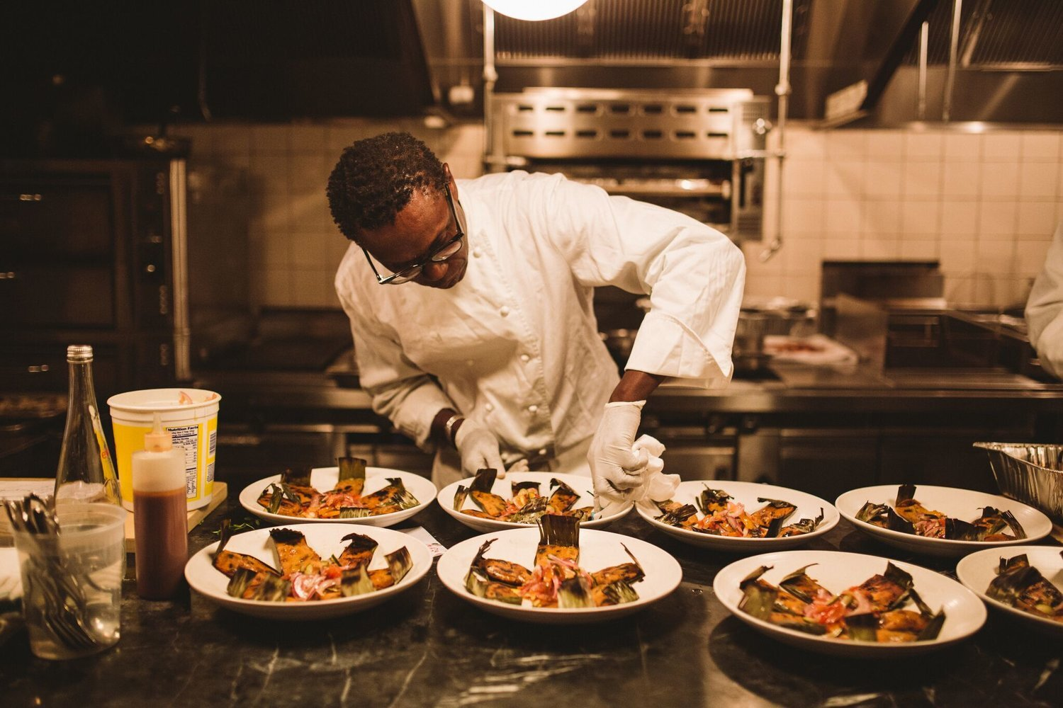
What we do
Everyone enjoys good food; I think we can all agree on that. However, everyone's definition of what is good food is different.
There are so many factors that influence our preferences that there is no universal food that everyone can enjoy.
Rather then try, we have created a site that will cover whatever preference you have and even some preferences that your have yet to discover.
Not just discover, but recreate and experiment, with Kitchen around you, you can try creating dishes from around that world.
Just sign up, and start cooking!!!!

Slide 3
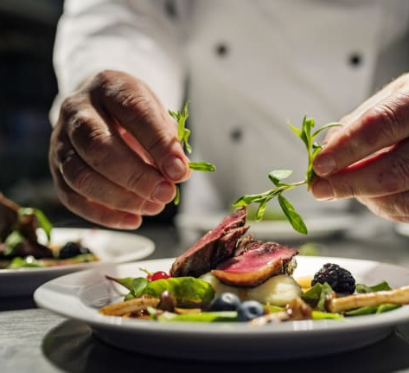
Concept:
We love cooking, its something that we all grew up admiring about our parents and grandparents. Learning to cook is not easy, some of us had to learn the hard way (trial and error). We wanted to find a way to make it more accessible to even the most tragic of soon-to-be chefs

Slide 4

Technology used
bcrypt ver. 5.0.1
Dotenv ver. 16.0.0
Express ver. 4.17.3",
express-session ver. 1.17.2
Handlebars ver. 4.7.7
Mysql2 ver. 2.3.3
Sequelize ver. 6.17.0
NodeMailer ver 6.7.2

Slide 5
Task breakdown:
Krupali Models Sessions API | Alex Routes Presentation | Fabian Front end

Slide 6

Challenges and Successes
Challanges
Success
Getting the routes to work
Defining the new package
Learning new tech and executing the tech in a short amount of time
Navigating file structure in front end
After merge code was breaking
Creating the models
Creating API and linking them to routes
Extending the email
User can login, sign up and register in a class

Slide 7

DEMO!!!

Slide 8
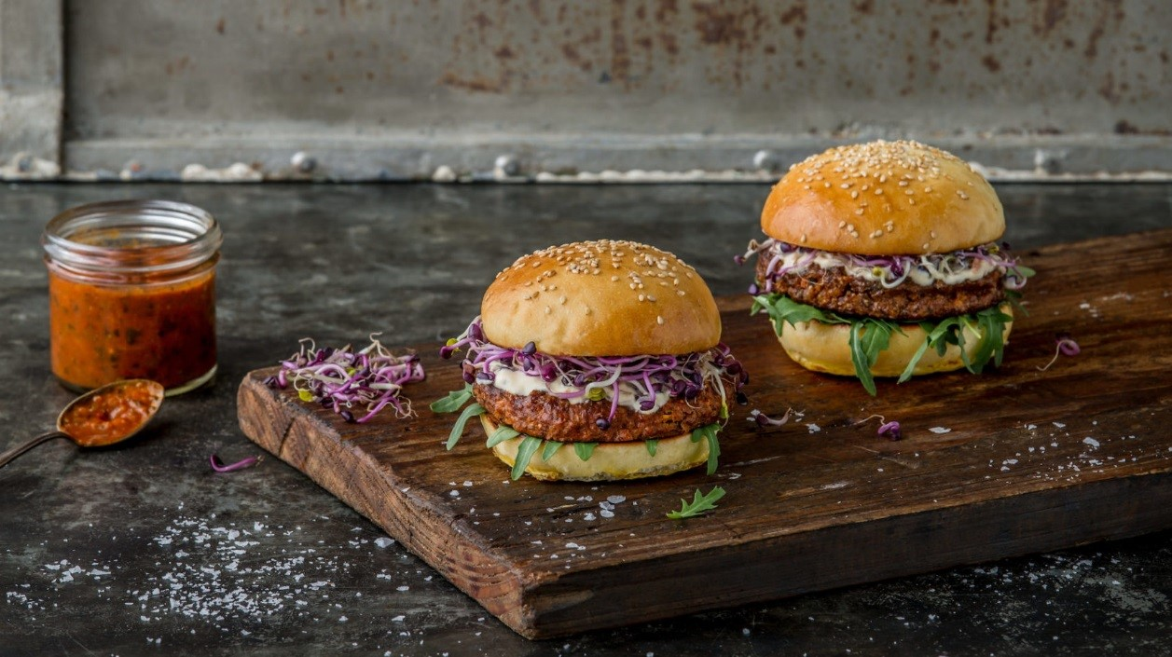
Future Enhancements:
Avoid duplicate registrations
Ability for user to cancel program enrollment
Add html to email to add more details and to enhance look and feel
Admin user who can see number of registrations per program
Feedback for program

Slide 9
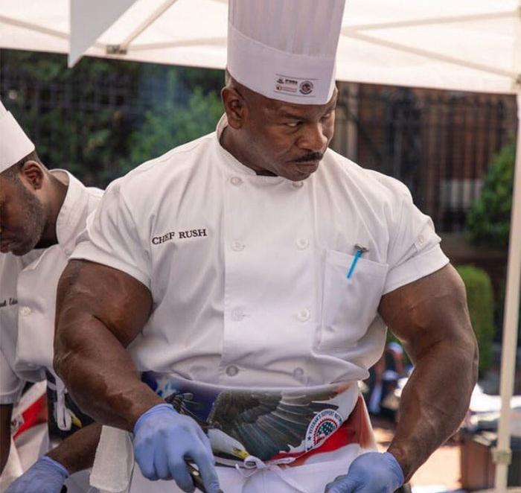
Links:
Github: https://github.com/rpkrupali1/kitchen-around-you
Deployed:
https://kitchen-around-you.herokuapp.com/

